Slide 1






MIL-OSS Hackathon a Recent IoT Success

Slide 2
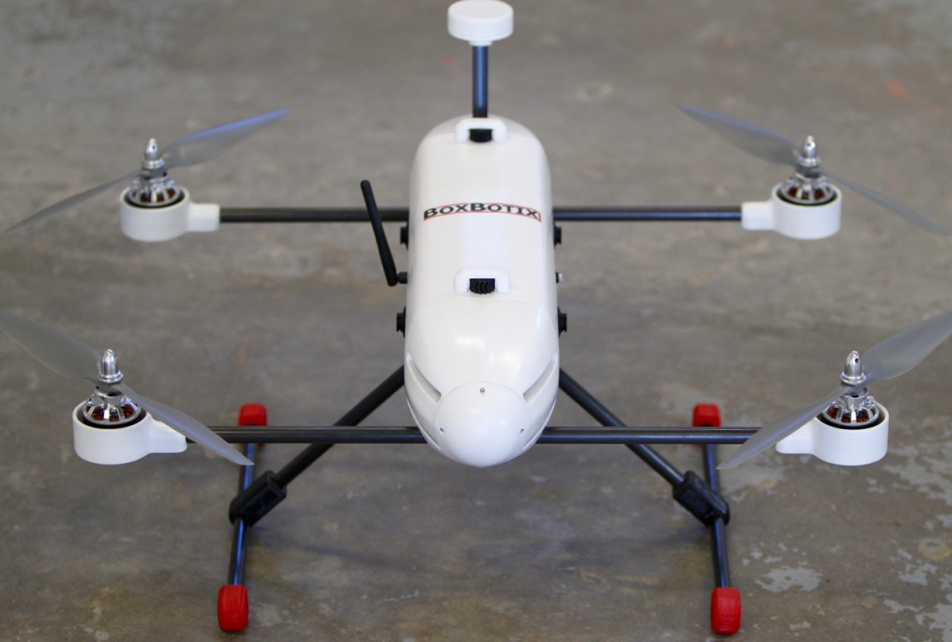
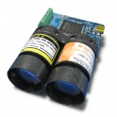

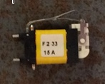

The MIL-OSS Challenge
Special Operations Forces operators need flexible options for mounting sensors to small UAVs (unmanned Aerial Vehicles or “Drones”)
Given a BoxBotix (http://boxbotix.com/) Quadcopter system and three different off-the-shelf sensors
  Design, 3D print, and assemble modular connectors (physical, electrical, and data) to integrate the given sensors to the BoxBotix system
Sensors provided for the challenge:
  LIDAR proximity sensor for
  “Soft Landing”
  GOTENNA blue tooth extender antenna
  Arming switch to prepare the UAV for action
“Be creative and augment the solution”
DO all of it in the rain and with gloves on …

Slide 3
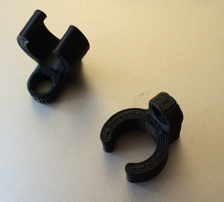
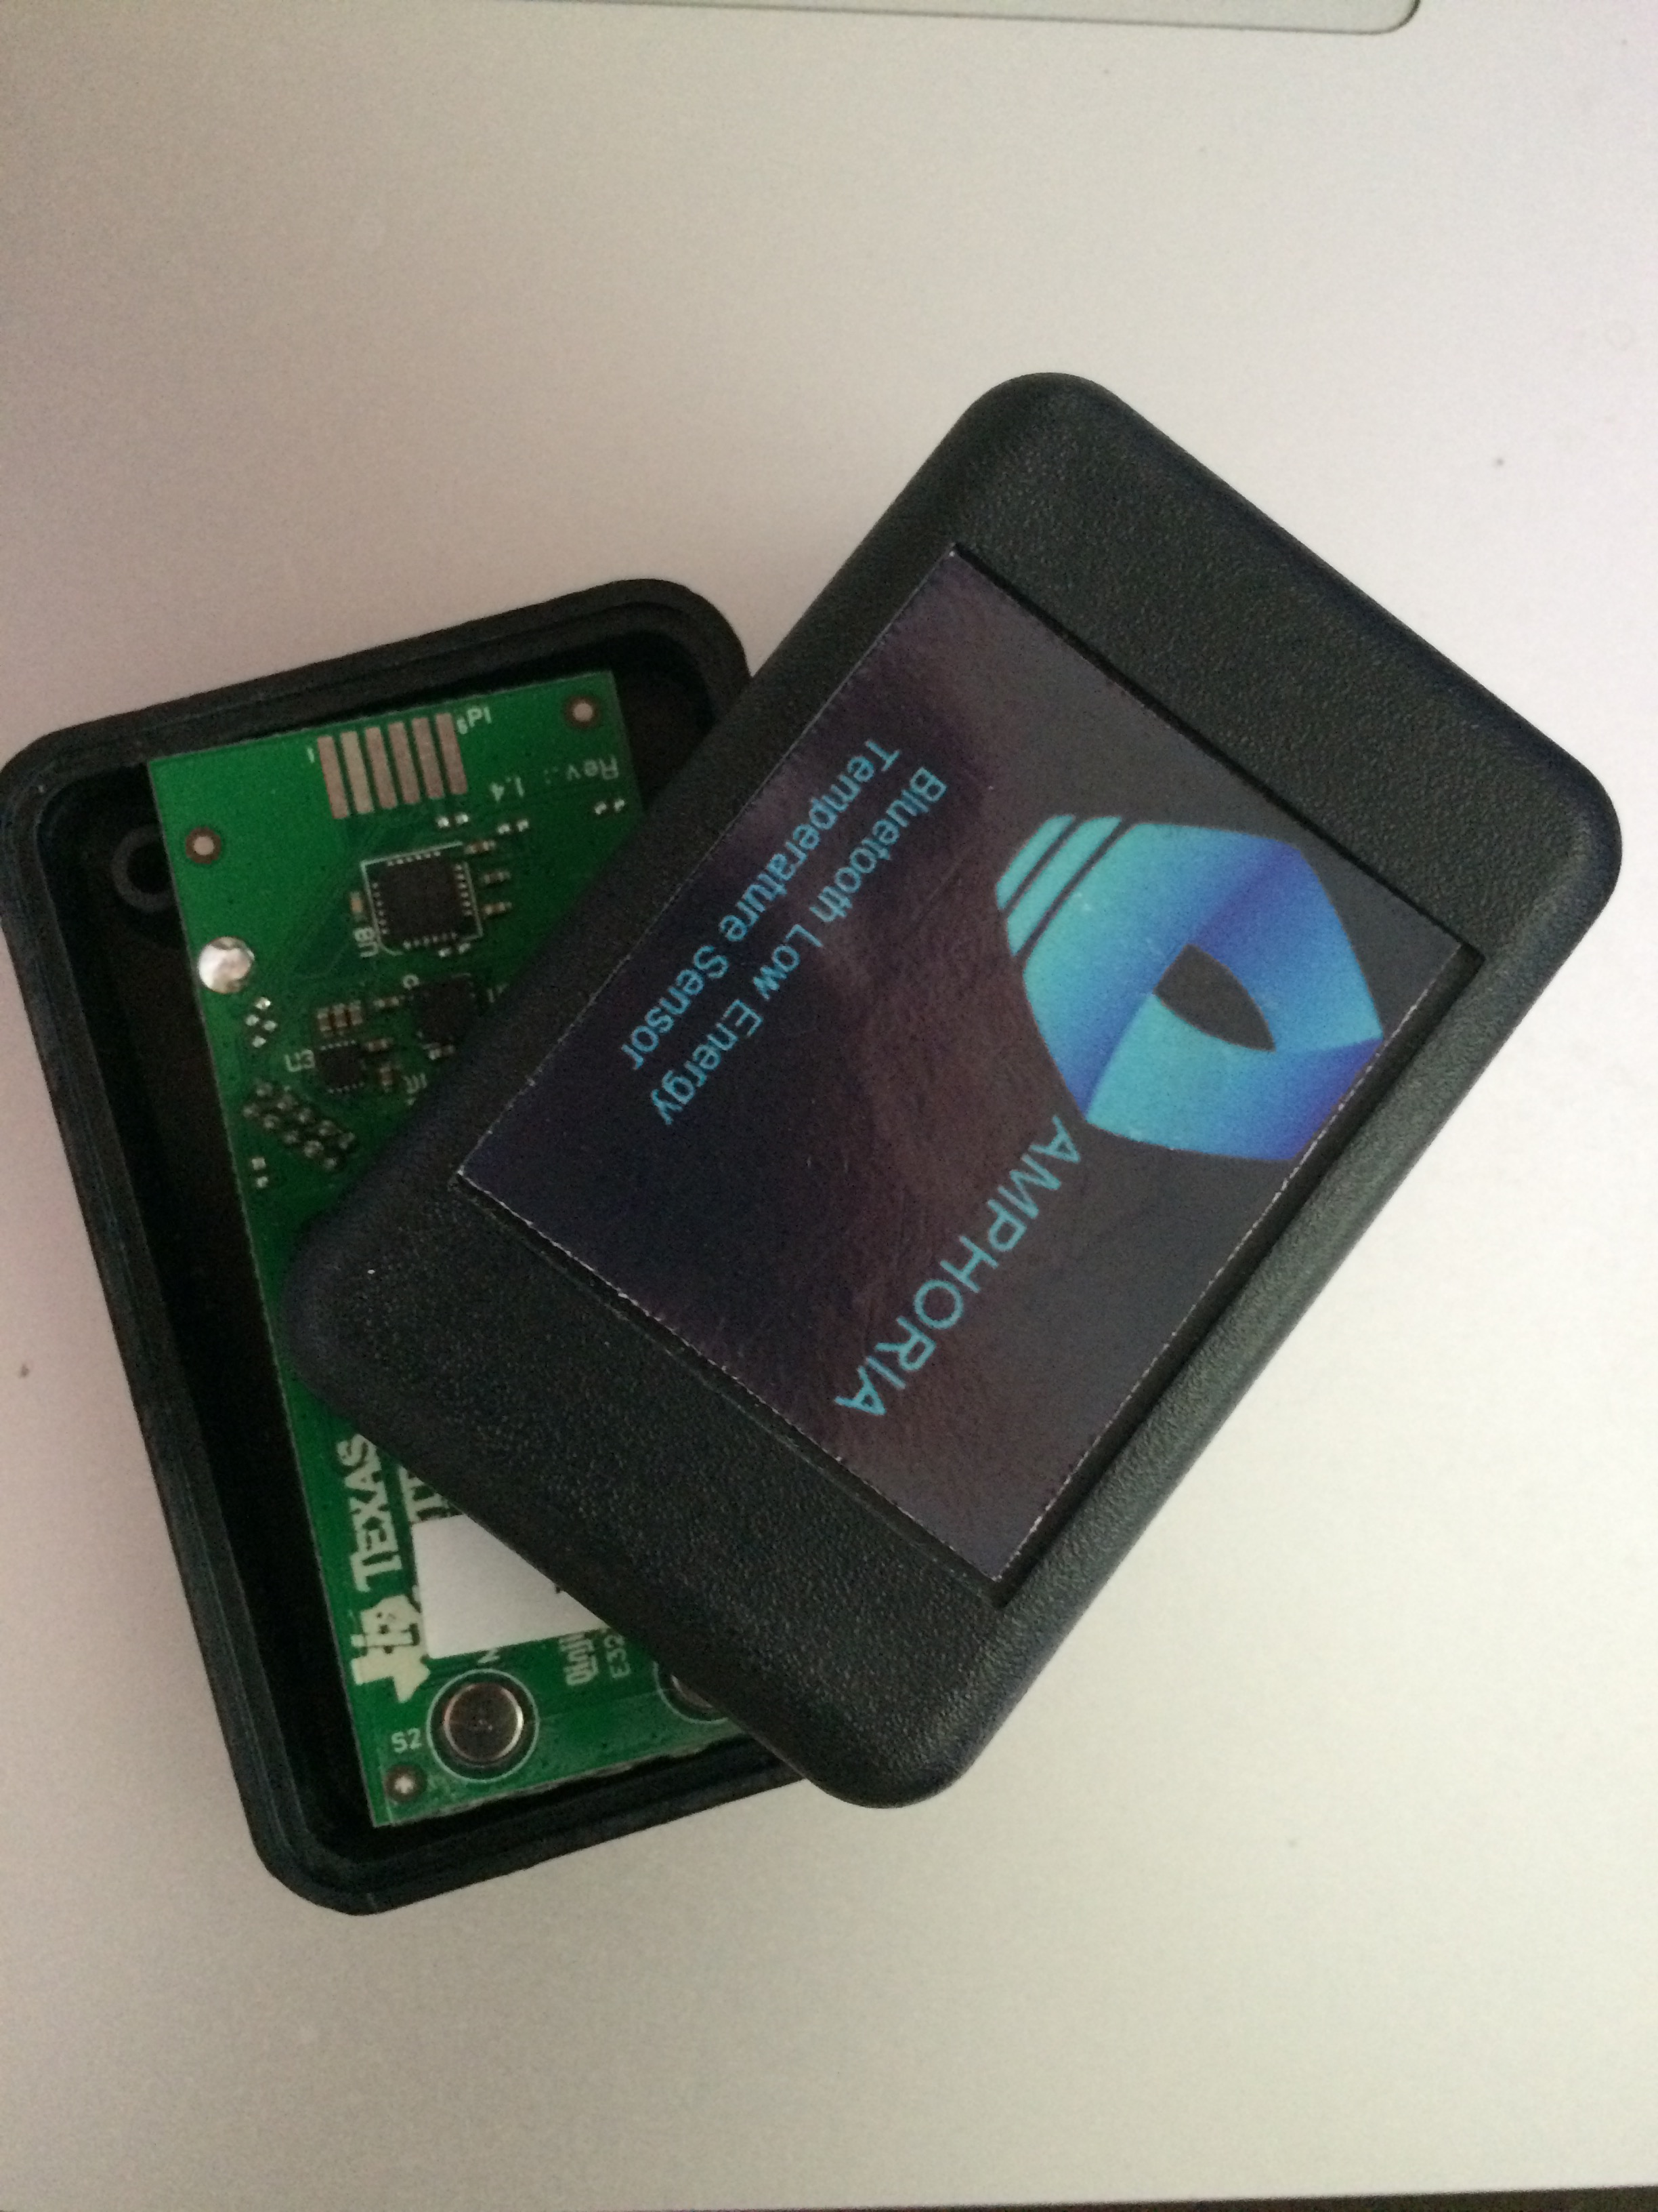
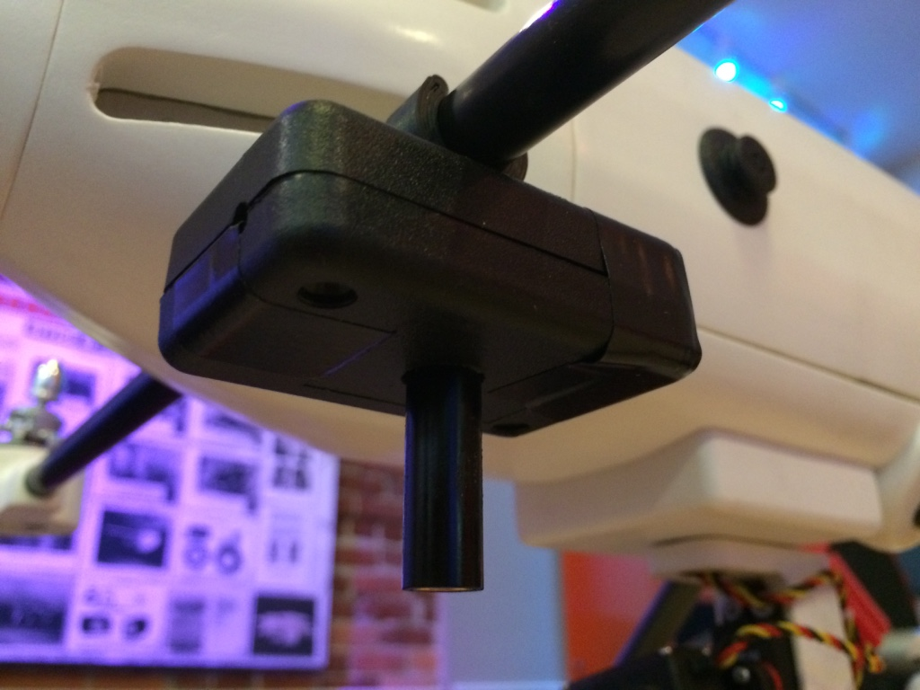
How we met the Challenge
3D printed attachment clips to leverage the “Drone” struts which are carbon fiber
3D printed the “sensor case” note “Amphoria” our sensor brand
Attached the clip to the sensor case and using the clip you can attach the sensor to the drone strut

Slide 4
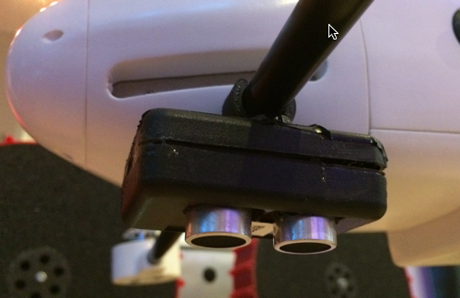
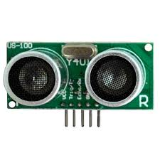
Our Thinking
Our goals to reduce “cost”, improve “simplicity”, reduce “weight”, increase “flight time”
Replaced the LIDAR proximity sensor with an Ultrasonic proximity sensor
$300
69 oz.
$3
6 oz.
In the case are the sensor, processor and battery

Slide 5
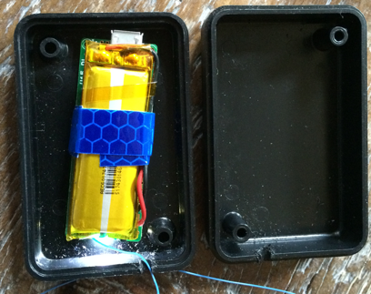
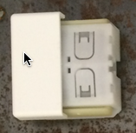
The remaining challenges
The guts of the GOTENNA removed from the original case and put into an Amphoria case and clip mounted to the strutt
The original Arming switch which would require drilling and running cables replaced with a wireless switch powered by ”Piezo electricity” (generated by the action of pushing the button) glued to bottom of Drone

Slide 6
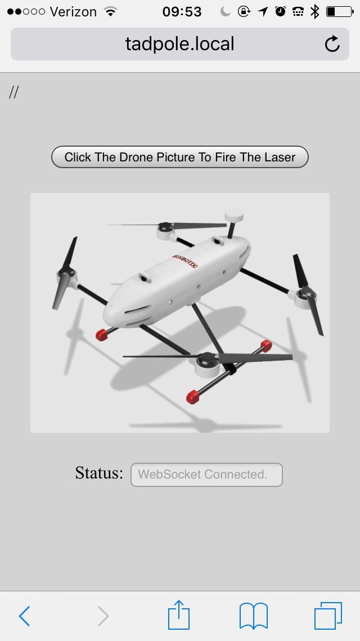
Stepped it up a “notch” … art of the possible
Added a commercial targeting laser (like a laser pointer)
Wrote a mobile application where any soldier can push an image and “arm” or turn on the laser
Used to target for the big brother drone that has the ordinance
Any soldier can Tap to Arm (turn on)

Slide 7
Hackathon Solution Advantages
Off the shelf components, lower cost and lower weight
Easy drone reconfiguration by mounting sensors using standard clips and sensor enclosures
  No drilling holes on the fuselage, no wires to run
All wireless radio operated – saves main power supply for flight time with a choice of band
  433MHz, 868MHz, 902MHz, WiFi, BLE, ZigBee
Allows for expansion (adding more sensors) using same mount and form factor ”art of the possible”

Slide 8
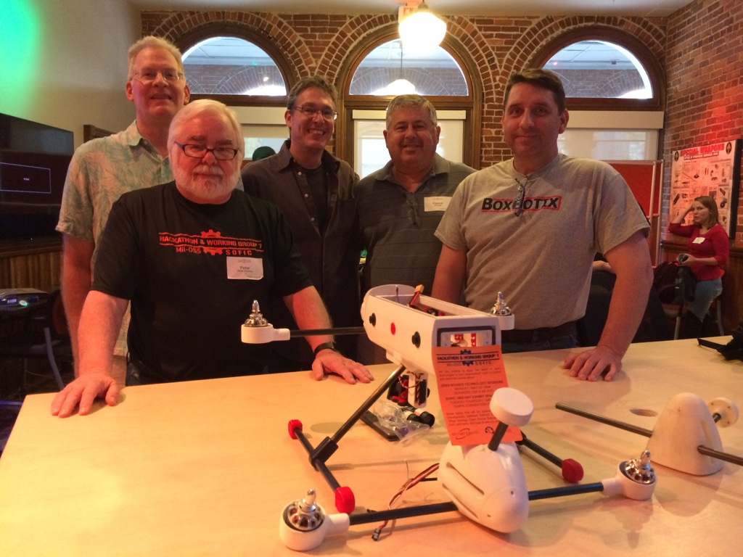



Our Team declared:
Winners of the Hackathon Challenge
All prize money donated to
We beat large Aerospace, DOD Integrators and Technology companies
Note: British Aerospace team came in2nd Place.

